Slide 1
Predicting the Predictors
Using Datascience to Forecast Value of Mobile App Users
October 2015

Slide 2

PRODUCT

Slide 3
OBJECTIVES
Predict if a user will spend money or not ?
Predict User Value of paying users

Slide 4
PART 1: DATA USED
Variables | Explanation
Platform | IOS or Android
Gender | M or F
Average Answer Speed | Time before they received a response to their question
Paid | 1 or 0

Slide 5
MODELS USED AND PERFORMANCE
MODEL | PERFORMANCE
BENCHMARK | 65.35 %
Logistic Regression | 77%
KNN | 75%
SVC | 77%
Random Forest | 73%

Slide 6
LOGISTIC REGRESSION COEFFICIENTS
Coefficients | Features
0.00 | Intercept
1.032 | C(platform) IOS
0.929 | C(gender) MALE
1.454 | AGE
1.061 | AVERAGE_ANSWER

Slide 7

WHAT DOES THIS MEAN
Marketing Budget Should be allocated towards older females. Avg age of Paying Users is 30
Make Sure the Psychics Answer Questions as soon as possible
IOS at this point is better than Android for paying users so more marketing funds should be allocated for IOS users

Slide 8
PART 2: DATA USED
Variables | Explanation
Platform | IOS or Android
Gender | M or F
Average Answer Speed | Time before they received a response to their question
Psychic Question % | What percentage of questions went to a particular psychic
User Value | Whale, High Roller, Player

Slide 9
MODELS USED AND PERFORMANCE
MODEL | PERFORMANCE
BENCHMARK | 36%
KNN | 44%
SVC | 40%
Random Forest | 68%
FEATURE | IMPORTANCE
Average_Answer | 21%
AGE | 17%
CYNTHIA | 9%

Slide 10
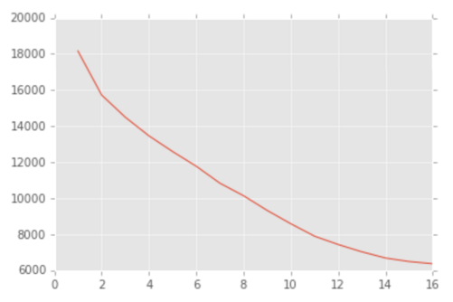
CLUSTERING
FEMALE
DOES IT IMPROVE PERFORMANCE
MALE
NO NOTICABLE EFFECT ON PERFORMANCE DUE TO SMALL DATA SIZE

Slide 11
WHAT DOES THIS MEAN
Marketing Budget Should be allocated towards older females. Avg age of Paying Users is 30
Make Sure the Psychics Answer Questions as soon as possible
The Psychic Cynthia is key to getting more Whales so have her placement in the app as high as possible
Start Engagement Campaigns towards potential Whales and Highrollers via Push Messaging and Email in order to further engage them as soon as possible

Slide 12
FUTURE IDEAS FOR IMPROVEMENT
TRACK APP START EVENT
TRACK LENGTH OF QUESTION AND LENGTH OF RESPONSE
MODEL TO PREDICT WHO MAY BE LAPSES USER AND REMARKET TO THEM
INCREASE SIZE OF DATA SET

